Slide 1
My work
Derivation of the Gyrokinetic equation in ITG mode
Influence of EGAM in ITG mode in the tokamak toroidal geometry
Double check on the eigenvalue of non-linear PDE via companion matrix method and initial value method

Slide 2

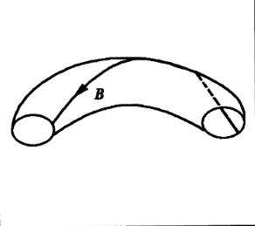
Derivation of the Gyrokinetic equation
In tokamak toroidal geometry——ITG mode
Where δH represents the Partition function which correspond to non-adiabatic response of the ion , v// is the velocity parallel to B. Vd is the drift velocity. J0 is Bessel function appeared in cylindrical coordinates. The right side of the equation represents the free energy which may excite the change of δH.

Slide 3




Derivation of the Gyrokinetic equation
Deploy a Fourier & Laplacian Transformation where δH has the form of exp[i(kr-ωt)]
Where

Slide 4

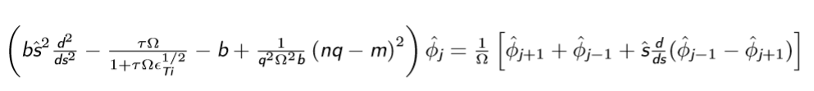

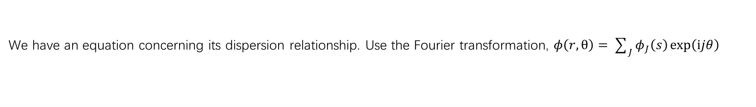
Derivation of the Gyrokinetic equation
Quasi-neutral condition with adiabatic response of electron and adiabatic & non-adiabatic response of ion
We have an equation concerning its dispersion relationship. Use the Fourier transformation, $φ\left(r,θ\right)=\sum_{J}{φ_{J}\left(s\right)\exp\left(ⅈjθ\right)}$
Where

Slide 5

Derivation of the Gyrokinetic equation
Transform into ballooning space
We have the PDE equation of ITG mode
Deploy numerical simulation

Slide 6

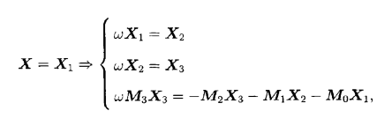
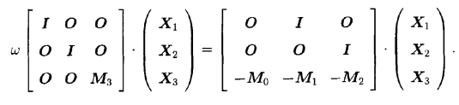


















Simulation and numerical computation
Companion matrix——eigenmatrix
D
$$φ$$
$$φ_{1}$$
$$φ_{2}$$
$$φ_{1}$$
$$φ_{1}$$
$$φ_{1}$$
$$φ$$
$$φ_{1}$$
$$φ_{2}$$
$$φ_{3}$$
$$φ_{2}$$
$$φ_{2}$$
$$φ_{3}$$
$$φ_{3}$$
$$φ_{2}$$
$$φ_{1}$$
$$φ_{3}$$
$$φ_{3}$$
This method cannot be used to analyze the non-linear procedure, but can give all eigenvalues of instable modes.

Slide 7






Simulation and numerical computation
Initial value method
D
$$ΔΩ=ⅈ\frac{∂}{∂t}$$
$$Ω→Ω_{0}+ΔΩ$$
Keep to the O($ΔΩ$)
This method can be used to analyze the non-linear procedure, but can only be used to analyze the most instable mode rather than all instable modes.

Slide 8
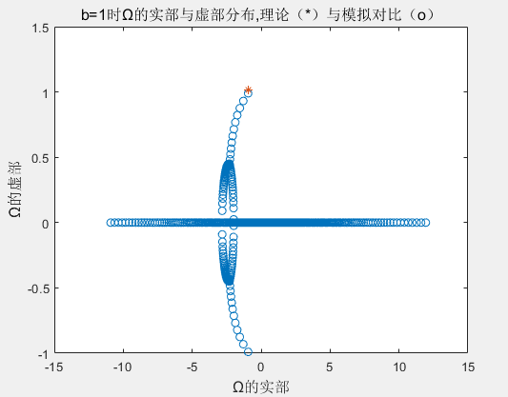
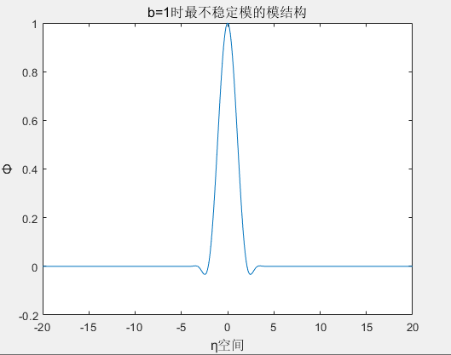
Simulation result——eigenmatrix
Theoretic result: -0.8808+0.9611i
Simulation result: -0.9409+0.9899i
Relative error of imag(Ω)=2.909%

Slide 9

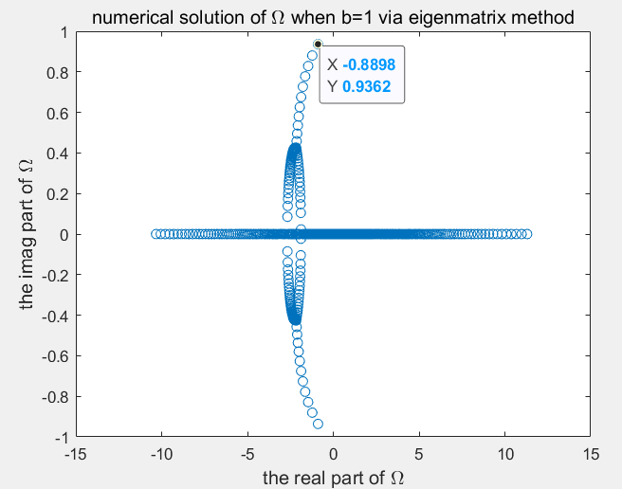
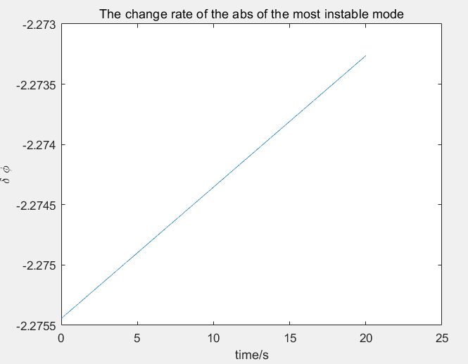

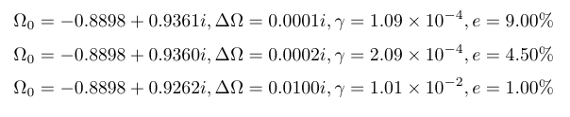


Simulation result
$$ΔΩ=ⅈ\frac{∂}{∂t}$$
$$Ω→Ω_{0}+ΔΩ$$
Matrix method
Initial value method

Slide 10
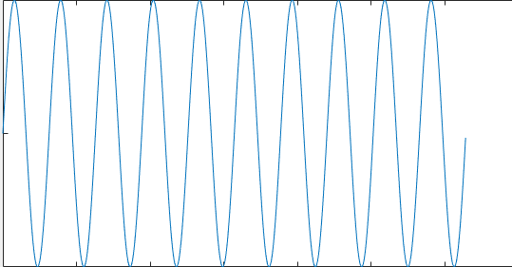


GAM In ITG mode
ITG
influence
ITG Pump
influence
GAM
Deploy numerical simulation

Slide 11
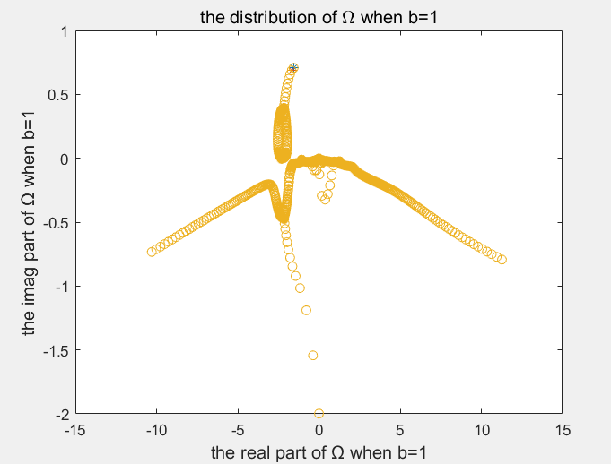
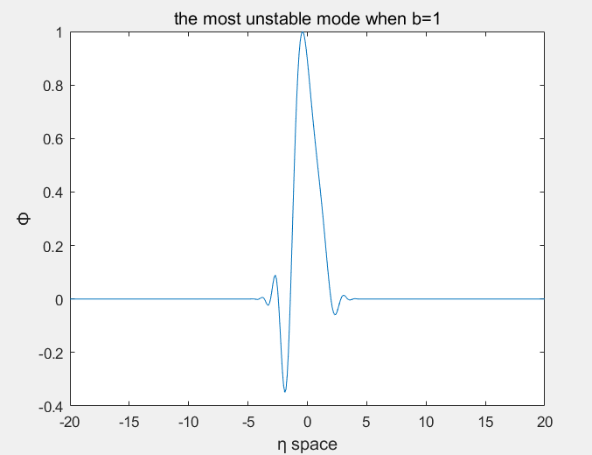
Simulation result——eigenmatrix
Theoretic result: -1.5640+0.7076i
Simulation result:-1.5596+0.7070i
Relative error of imag(Ω)=8.487e-04

Slide 12
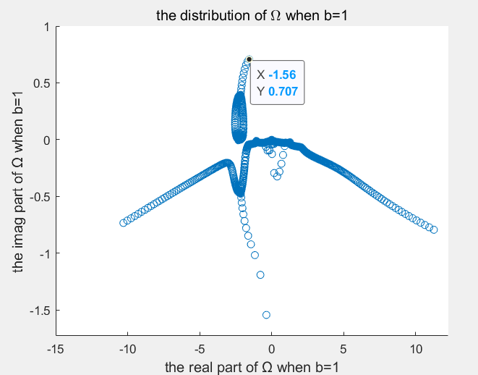
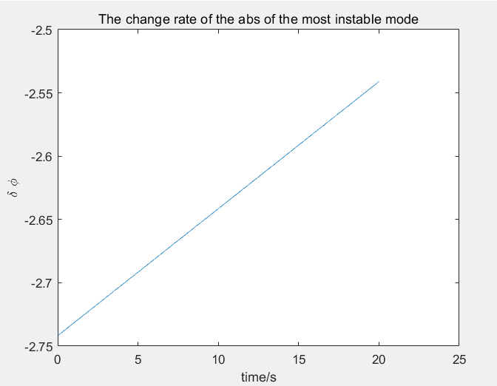




Simulation result
$$ΔΩ=ⅈ\frac{∂}{∂t}$$
$$Ω→Ω_{0}+ΔΩ$$
Matrix method
Initial value method

